Slide 1


Customer Churn Prediction & Analysis
In The Telco Industry
DEPI Graduation Project · CAI4_AIS4_G2 · Group 1
Mohamed Ibrahem Rady Ahmed Esmail
Amr El-Azab Mohamed Abdul Aziz
May 2026

Slide 2






Agenda
01
Introduction & Overview
Problem, dataset, objectives
02
Milestones 1 & 2 — Exploratory and Advanced Data Analysis
EDA, feature engineering, statistics
03
Milestone 3 — Machine Learning
5 models, tuning, winner selection
04
Milestone 4 — Deployment
Streamlit app, MLOps, GitHub
05
Milestone 5 — Project Documentation
Project Report and Project Presentation
06
Conclusions, Recommendations and Action Plan
Insights, recommendations, action plan

Slide 3
1
Introduction & Overview
Presenter: Mohamed Ibrahem

Slide 4
Customer Churn & Project Objective
Why It Matters
Definition
Customer churn (attrition) refers to customers who stop doing business with a company. In telecom, it means subscribers cancelling or switching to a competitor.
5×
more costly to acquire
a new customer
Churn Rate Formula
27%
Churn Rate =
# Churned Customers Over a Given Period
churn rate in our
dataset
Total # Customers at Start of The Period
X 100
$$$
Project Objective
direct revenue
loss per churner
Building a machine learning model – utilizing data science techniques such as data collection, exploration, feature engineering, machine learning, etc. – to predict customer churn.

Slide 5
Customer Churn Dataset Overview
7,043
21
27%
Kaggle
Customer Records
Features
Churn Rate
Data Source
Demographics
Services
Gender, Age, Senior Citizen, Partner, Dependents
Phone, Internet, Streaming, Tech Support, Security
Account
Target
Contract Type, Payment Method, Billing, Tenure
Churn (Yes / No) — Binary Classification

Slide 6
2
Exploratory & Advanced Data Analysis
Presenter: Ahmed Esmail

Slide 7
Milestone 1 — Data Collection, Exploration & Preprocessing
Exploratory Data Analysis (EDA)
Data Cleaning
Missing value and duplicate analysis
Numerical and categorical analysis
Distribution analysis
Handled missing values, outliers
Standardized inconsistent categories
Converted some datatypes into numerical formats
Visualizations
Bar Charts, Pie Charts
Histograms
Boxplots

Slide 8
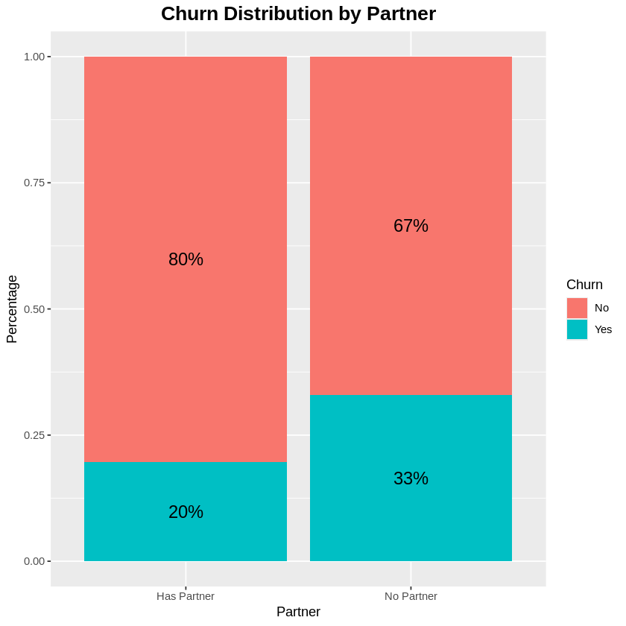
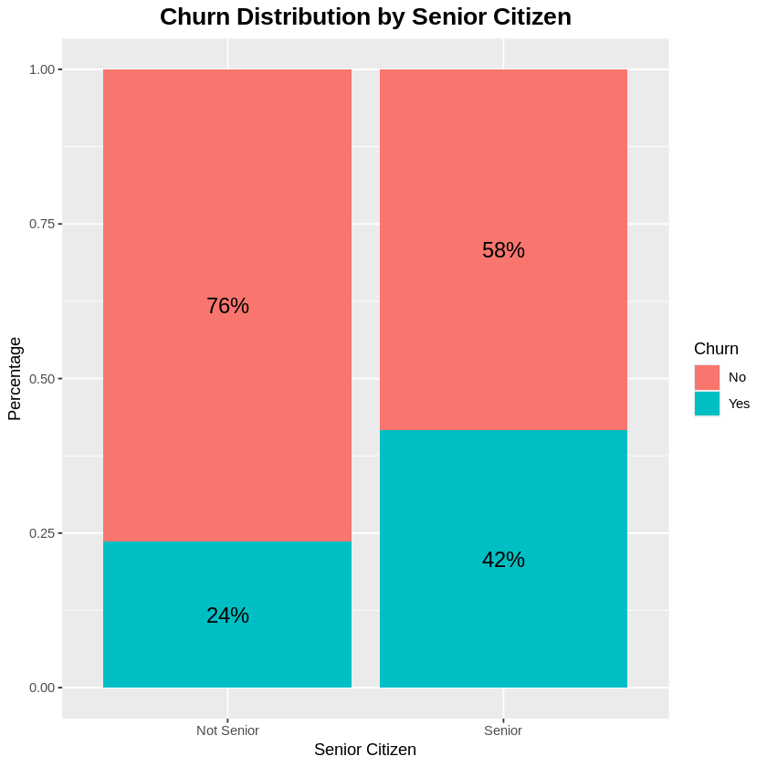
Milestone 1 — Data Collection, Exploration & Preprocessing
Partner Analysis
Senior Citizen Analysis

Slide 9
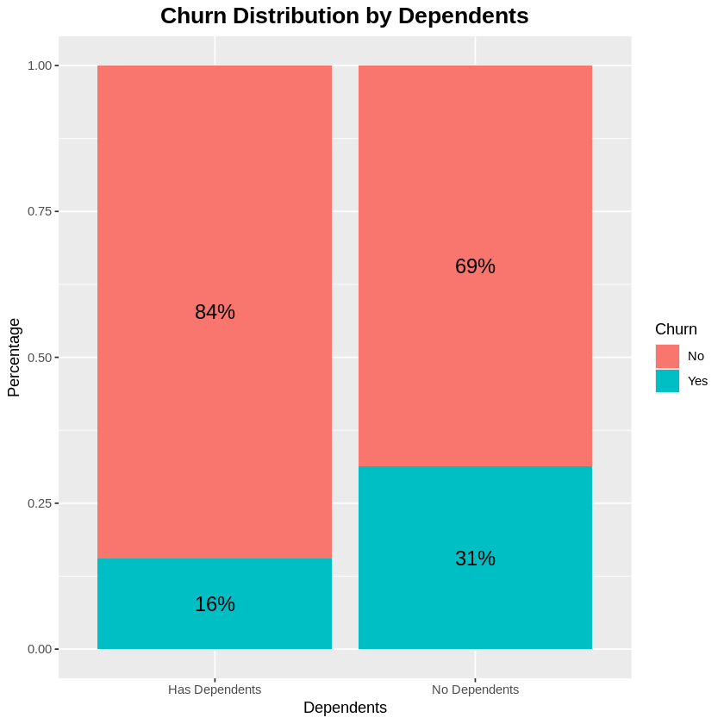
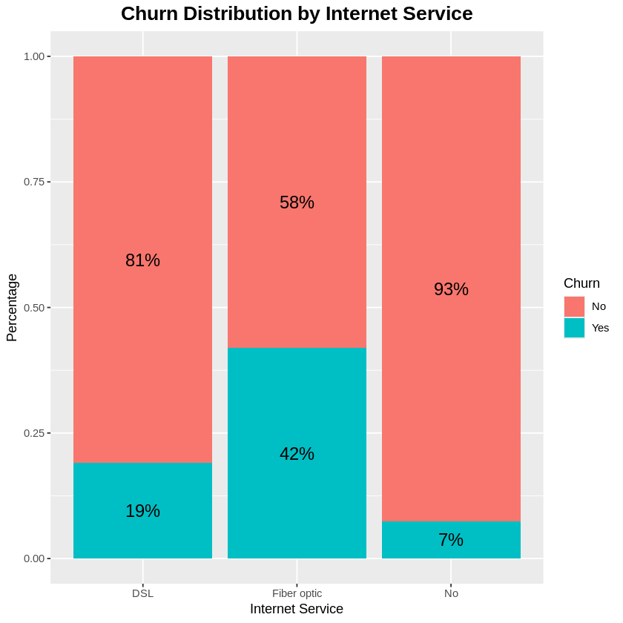
Milestone 1 — Data Collection, Exploration & Preprocessing
Dependents Analysis
Internet Service Analysis

Slide 10
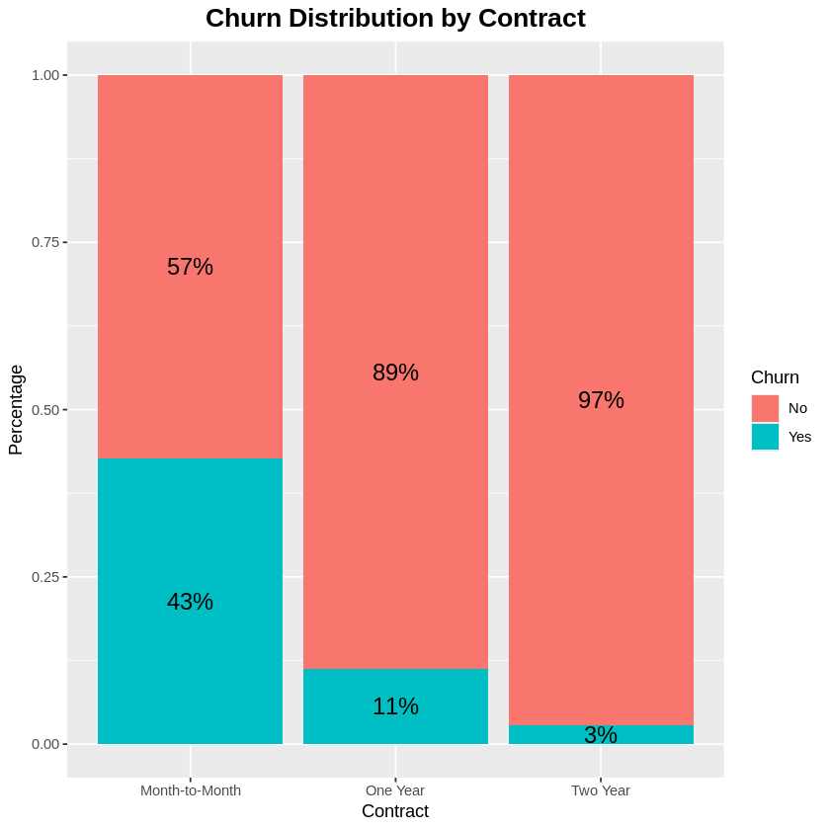
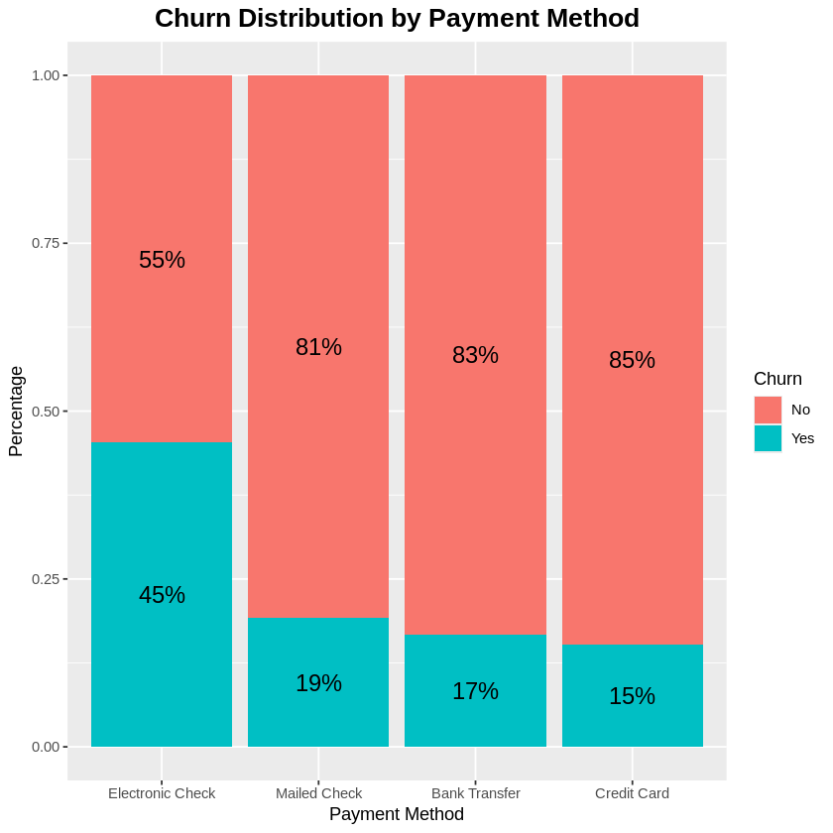
Milestone 1 — Data Collection, Exploration & Preprocessing
Contract Analysis
Payment Method Analysis

Slide 11
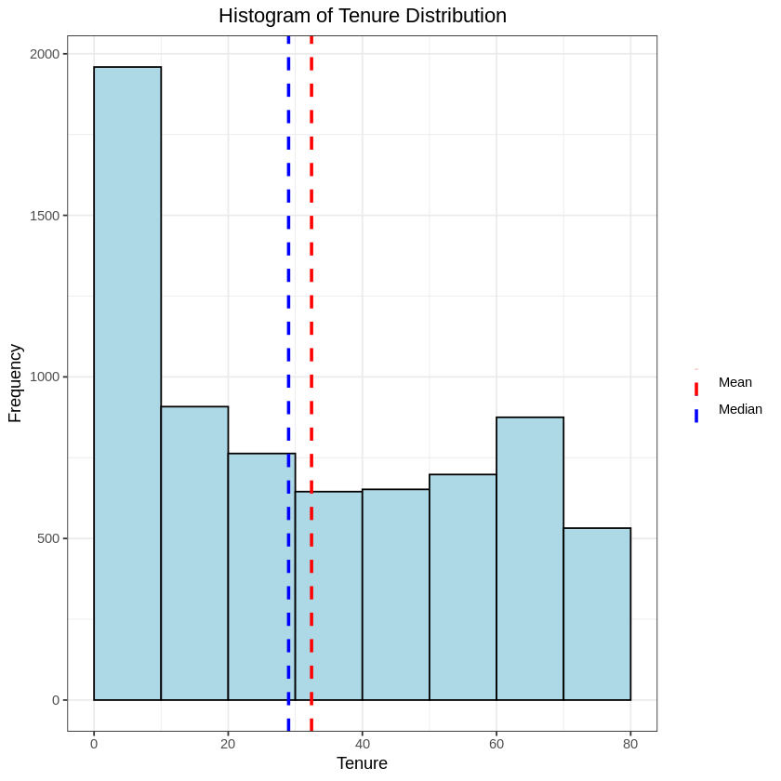
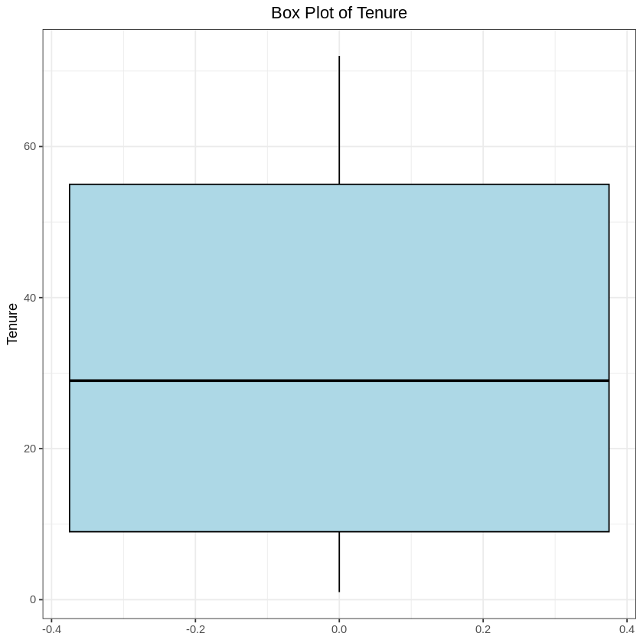
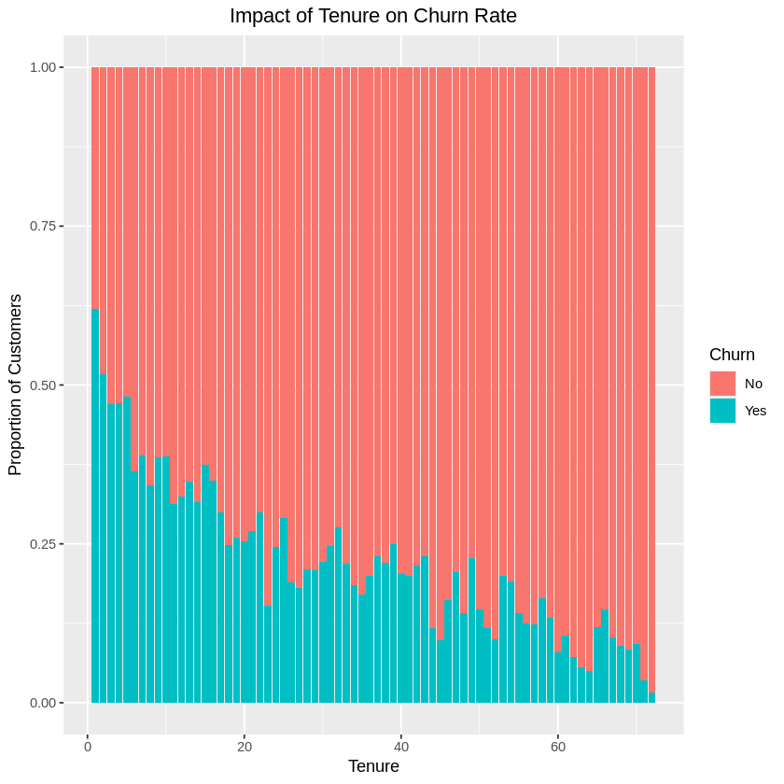
Milestone 1 — Data Collection, Exploration & Preprocessing
Tenure Analysis

Slide 12


Milestone 1 — Churn Distribution Analysis
27% overall churn rate across 7,043 customer records · Key demographic and service-level patterns identified
45%
Electronic check
churn rate (highest)
43%
Month-to-month
contract churn
3%
Two-year contract
churn (lowest)

Slide 13
Milestone 2 — Statistical Tests & Feature Engineering
Statistical Tests
Engineered Features
T-Tests
Charge Per Service, Average Monthly Spend,
Total Services,
Variables: Tenure, Monthly Charges, Total Charges
✓ Significant difference between churned & retained customers
Long-Term Customer Flag, Tenure Groups
Data Preparation for ML
Chi-Squared
Variables: Contract, Internet Service, Payment Method, Tech Support, Online Security
One-hot encoding for categorical variables
✓ Strong statistical relationship with churn
MinMaxScaler normalization
Feature Selection
Random Forest, RFE

Slide 14
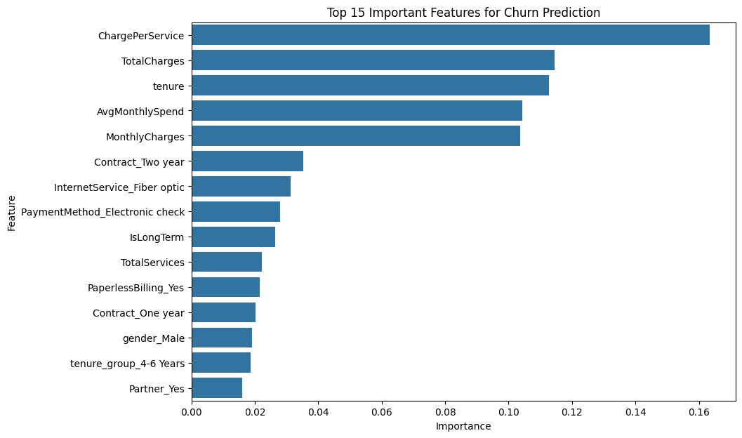
Milestone 2 — Top 15 Features for Churn Prediction
Key Takeaways
ChargePerService is the strongest predictor
Tenure & charges dominate top 5
Contract type & fiber optic are top categorical features
Electronic check payment signals high risk
15 features selected for ML

Slide 15
3
Machine Learning Model Development
Presenter: Amr El-Azab

Slide 16
Milestone 3 — Machine Learning
7,043
~27%
5
Customers Analyzed
Churn Rate
Models Tested & Compared
Predicting Customer Churn
Spotting customers who are likely to leave – early enough to keep them

Slide 17




Milestone 3 — Machine Learning
What We Did:
1. Prepared the Data
2. Balanced the Picture
A clear, four-step process to build a reliable churn predictor.
Cleaned 7,043 customer records described by 15 signals — tenure, charges, contract type, services and more.
Churners were the minority, so we balanced the training data (SMOTE) so the model learns to spot them, not ignore them.
3. Trained & Compared 5 Models
4. Validated & Fine-Tuned
Tested five different approaches side by side on data the models had never seen, using fair, like-for-like metrics.
Confirmed results were stable (5-fold cross-validation) and tuned the strongest models for the best practical performance.

Slide 18
Milestone 3 — Results & Recommendations
Gradient Boosting was selected as the best model for retention.
Recommendation
79%
of customers who leave are now correctly flagged
Deploy Gradient Boosting to score customers by churn risk and flag the highest-risk ones for proactive retention offers. The model catches roughly 4 in 5 likely leavers; the few false alarms cost only an offer, while each missed churner is a lost customer.
0.84
ROC-AUC — strong at ranking customers by risk
Gradient Boosting
✓ Deploy Gradient Boosting
the winning model, chosen on balanced performance

Slide 19
4
Deployment & MLOps
Presenter: Mohamed Ibrahem Rady

Slide 20
Milestone 4 — MLOps Pipeline & Deployment
Data
Prep
Model
Training
Model
Save
FastAPI / Streamlit
Cleaned &
Engineered
Classifiers
+ Tuning
.joblib &
.json & .pkl files
depi-ccpa
.streamlit.app
Tools & Infrastructure
→ GitHub Repository (Eng-MIR/DEPI4-CCPA)
→ Streamlit Cloud deployment — live at depi4-ccpa.streamlit.app
→ Model versioning via MLflow
→ 4 team members as GitHub contributors

Slide 21
Milestone 4 — MLOps Pipeline & Deployment
Data Collection
Data Preprocessing
Feature Engineering
Model Training
MLFlow Experiment Tracking
Model Evaluation
Model Serialization
FastAPI Deployment
Streamlit Dashboard
Retraining Pipeline
MLOps Pipeline Architecture
The implemented MLOps workflow includes:

Slide 22
Milestone 4 — MLOps Pipeline & Deployment
MLFlow Integration
Saved Artifacts
Used MLflow for:
Experiment tracking
Parameter logging
Metric tracking
Model versioning
Trained model
Scaler
Evaluation results
Benefits
Reproducibility
Traceability
Easy model comparison

Slide 23
Milestone 4 — Deployment, UI & Retraining Strategy
FastAPI Deployment
Streamlit Dashboard
Model deployed using FastAPI as REST API.
API Features
Real-time predictions
JSON request/response
Swagger UI testing
Built interactive dashboard using Streamlit.
Dashboard Features
User-friendly inputs
Churn probability prediction
Real-time results
Retraining Strategy
Future Improvements
Retrain model
Performance decreases
New data becomes available
Cloud deployment
Docker containerization
CI/CD automation
Automated retraining pipeline

Slide 24
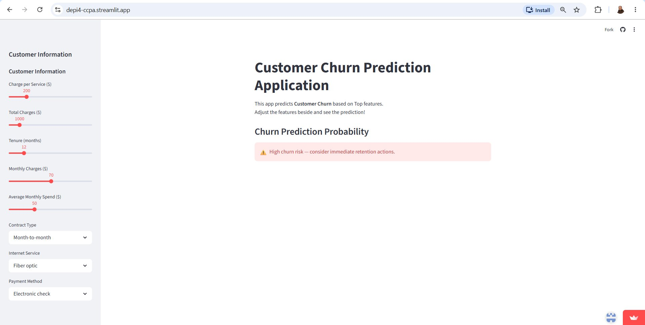

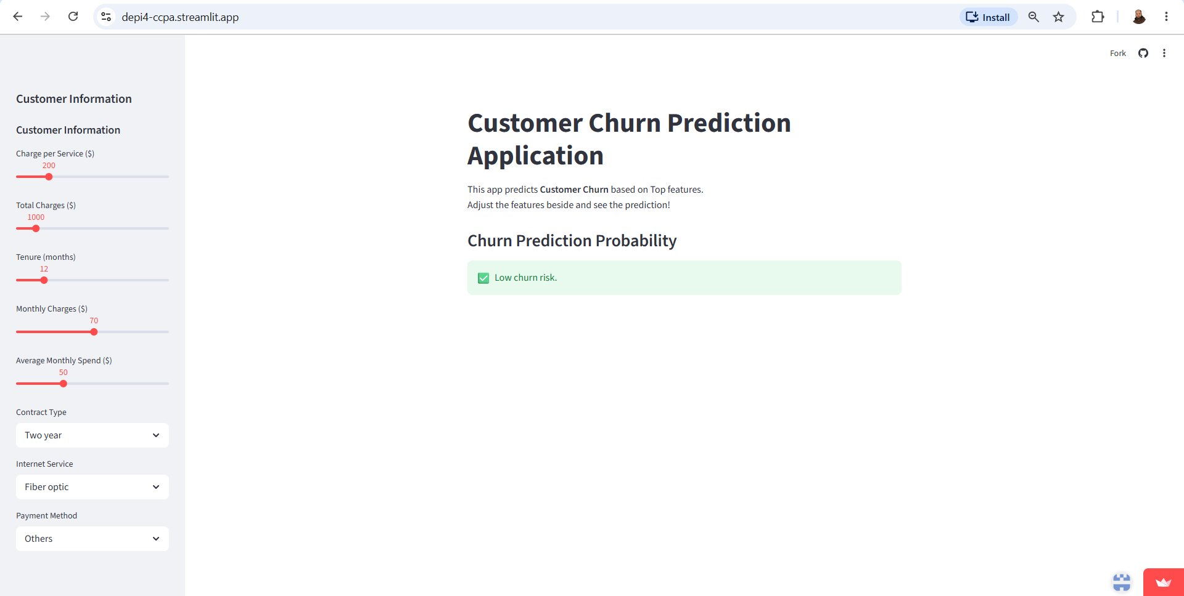
Milestone 4 — Live Demo: Customer Churn Prediction App
App Features
Real-time churn prediction using Gradient Boosting model
Interactive sliders for charges, tenure & monthly spend
Dropdown selectors: contract type, internet, payment method
Red alert — High churn risk: immediate retention action needed
Green alert — Low churn risk: customer is stable
Live URL: depi4-ccpa.streamlit.app

Slide 25
5
Documentation
Presenter: Mohamed Abdul Aziz

Slide 26
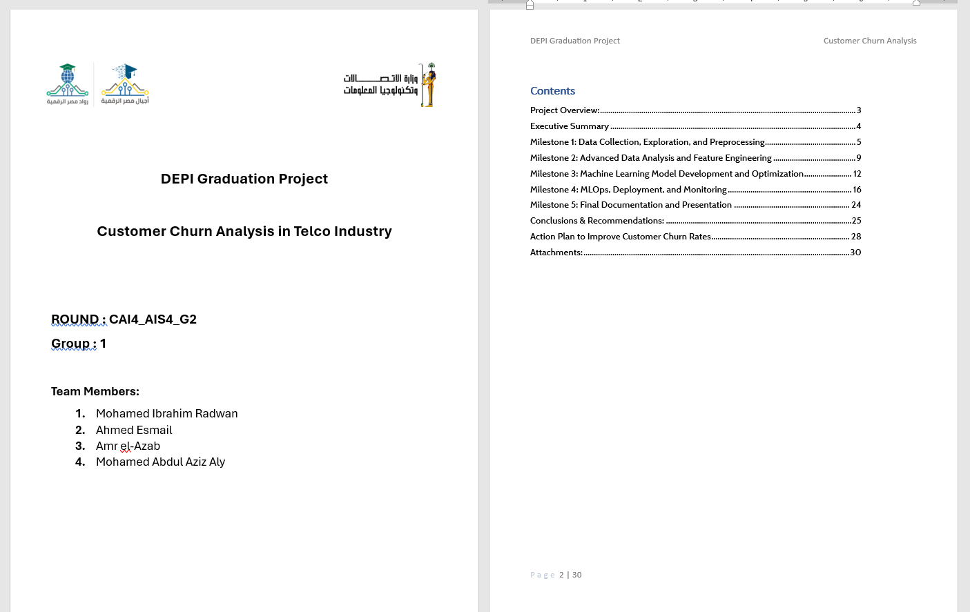
Milestone 5 — Project Deliverables Summary

Slide 27
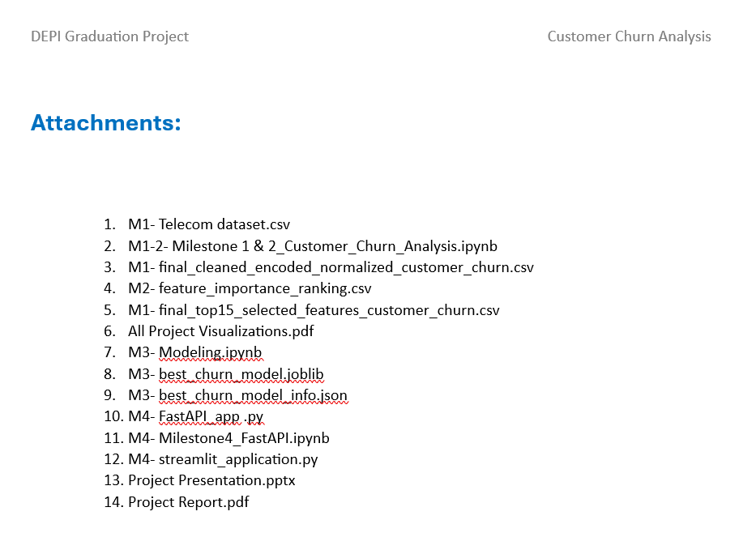
Milestone 5 — Project Deliverables Summary
M1 — Data Collection & EDA
M5 — Documentation
M2 — Advanced Analysis
EDA Report
Final Project Report
Statistical Analysis Report
Interactive Visualizations
Final Presentation
Enhanced Visualizations
Cleaned Dataset
Feature Engineering Summary
M3 — ML Development
M4 — Deployment
Model Evaluation Report
Live Streamlit App
Model Code (Python)
GitHub Repository
Final Model (Gradient Boosting)
Model Metadata (.joblib + .json)

Slide 28
6
Conclusions, Recommendations & Action Plan
Presenter: Mohamed Abdul Aziz

Slide 29


Key Conclusions from the Analysis
Contract Type is #1 Churn Driver
Tenure is a Critical Retention Signal
Month-to-month customers churn 14× more than two-year contract holders (43% vs. 3%)
Churn drops sharply after 12 months — early engagement is the most impactful intervention
Fiber Optic Customers Are High-Risk
Value-Added Services Reduce Churn
Despite being the largest group (44%), they churn at 42% — suggesting service quality issues
Customers with online security, tech support, and backup have significantly lower churn rates
Gradient Boosting is the Best Model
Proactive Retention is Viable
AUC = 0.839, Recall = 80.8% — catches 4 in 5 likely churners before they leave
ML model deployed live — enables real-time scoring and early retention interventions

Slide 30
Recommendations Summary
# | Finding | Recommendation
1 | Month-to-month contracts have 43% churn | Incentivize migration to longer-term contracts
2 | Fiber optic churn = 42% | Improve service quality; targeted retention offers
3 | Electronic check churn = 45% | Incentivize switch to auto-pay or credit card
4 | partner/dependents = lower churn | Family and partnership bundled service discounts (for retention)
5 | Senior citizens churn at 42% | Dedicated senior support and simplified plans
6 | No value-added services = higher churn | Promote security, backup, and tech support bundles
7 | Short tenure customers churn more | Improve onboarding; offer first-year loyalty bonus
8 | Paperless billing users churn more (34%) | Digital-first engagement and personalized comms

Slide 31
Action Plan — Reducing Customer Churn
Improve Satisfaction & Engagement
Optimize Pricing & Contracts
1
2
Regular surveys, faster support response, reduce complaint resolution time
Discounts for long-term commitments, flexible contract options, loyalty programs
Proactive Retention Program
Enhance New Customer Onboarding
3
4
Target high-risk customers flagged by ML model with exclusive retention offers
Welcome calls, tutorials, early engagement — reduce first-year churn
Improve Fiber Optic Service Quality
Leverage Predictive Analytics
5
6
Address reliability issues, invest in infrastructure, premium support tiers
Continuous monitoring via dashboards, retrain model quarterly on new data

Slide 32
Thank You
We welcome your questions
→ GitHub: github.com/Eng-MIR/DEPI4-CCPA
→ Streamlit App: depi4-ccpa.streamlit.app
→ Dataset: Kaggle — Telco Customer Churn
Team:
Mohamed Ibrahem · Ahmed Esmail · Amr El-Azab · Mohamed Abdul Aziz

Slide 33
BACKUP SLIDES
Available on request during Q&A

Slide 34
Future Improvements & Retraining Strategy
1
2
3
XGBoost / LightGBM
Deep Learning
Real-Time Data Pipeline
Test more powerful gradient boosting variants for higher recall
Explore neural networks for complex feature interaction capture
Connect live CRM data feeds for continuous model scoring
4
5
6
Explainability (SHAP)
Quarterly Retraining
Cloud Scaling
Add SHAP values to explain individual predictions to retention teams
Automated pipeline: monitor data drift → trigger retraining → redeploy
Move from Streamlit to FastAPI + cloud (AWS/GCP) for enterprise scale

Slide 35
Backup — Full Model Metrics (All Models & Variants)

Slide 36
Backup — Additional EDA: Partner, Dependents & Senior Citizen
• Customers without a partner churn at 33% vs. 20% with a partner
• Senior citizens churn at 42% vs. 24% for non-seniors
• Customers without dependents churn at 31% vs. 16% with dependents

Slide 37
Backup — Full Recommendations Summary
# | Finding | Recommendation
1 | Month-to-month contracts have 43% churn | Incentivize migration to longer-term contracts
2 | Fiber optic churn = 42% | Improve service quality; targeted retention offers
3 | Electronic check churn = 45% | Incentivize switch to auto-pay or credit card
4 | No partner/dependents = higher churn | Family and partnership bundled service discounts
5 | Senior citizens churn at 42% | Dedicated senior support and simplified plans
6 | No value-added services = higher churn | Promote security, backup, and tech support bundles
7 | Short tenure customers churn more | Improve onboarding; offer first-year loyalty bonus
8 | Paperless billing users churn more (34%) | Digital-first engagement and personalized comms

Slide 38
Milestone 3 — Modeling Pipeline
1. Data Split
2. SMOTE Balancing
3. 5 Classifiers Trained
Stratified 80/20 split preserving 73/27 churn ratio
Applied only to training set to prevent data leakage on test set
Logistic Regression, Random Forest, Gradient Boosting, KNN, Naïve Bayes
4. 5-Fold CV
5. Hyperparameter Tuning
6. Winner Selection
SMOTE wrapped inside imblearn Pipeline — no leakage into validation fold
GridSearchCV applied to top-2 baselines: Gradient Boosting & Random Forest
Final model chosen by F1-score — optimal for imbalanced churn detection

Slide 39
Milestone 3 — Model Performance Comparison
Model | Accuracy | Precision | Recall | F1-Score | ROC-AUC
★ Gradient Boosting (tuned) | 74.7% | 51.5% | 80.8% | 62.9% | 0.839
Gradient Boosting | 76.4% | 53.7% | 79.1% | 64.0% | 0.839
Logistic Regression | 72.7% | 49.1% | 80.8% | 61.1% | 0.833
Random Forest (tuned) | 77.0% | 55.6% | 66.8% | 60.7% | 0.822
Naïve Bayes | 69.9% | 46.3% | 83.9% | 59.7% | 0.815
Random Forest | 76.9% | 55.6% | 64.2% | 59.6% | 0.812
KNN | 72.0% | 48.2% | 72.5% | 57.9% | 0.778
★ Winner by F1-Score and Recall — best for churn detection

Slide 40
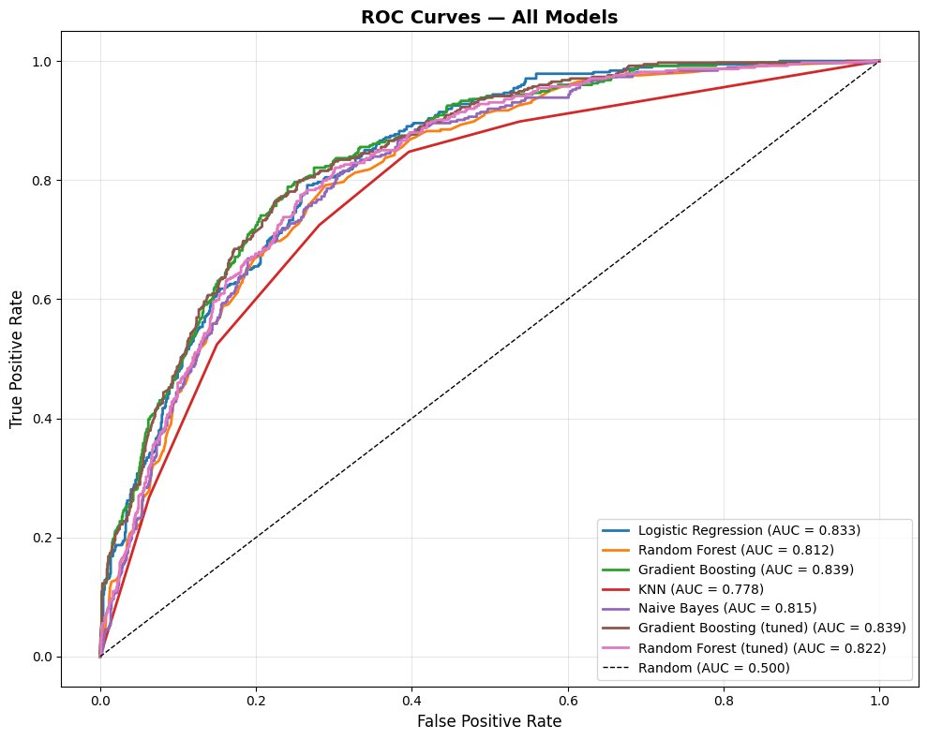
Milestone 3 — Model Evaluation: ROC Curves
Top AUC Scores
Gradient Boosting (tuned)
AUC = 0.839
Logistic Regression
AUC = 0.833
Random Forest (tuned)
AUC = 0.822
Naïve Bayes
AUC = 0.815

Slide 41
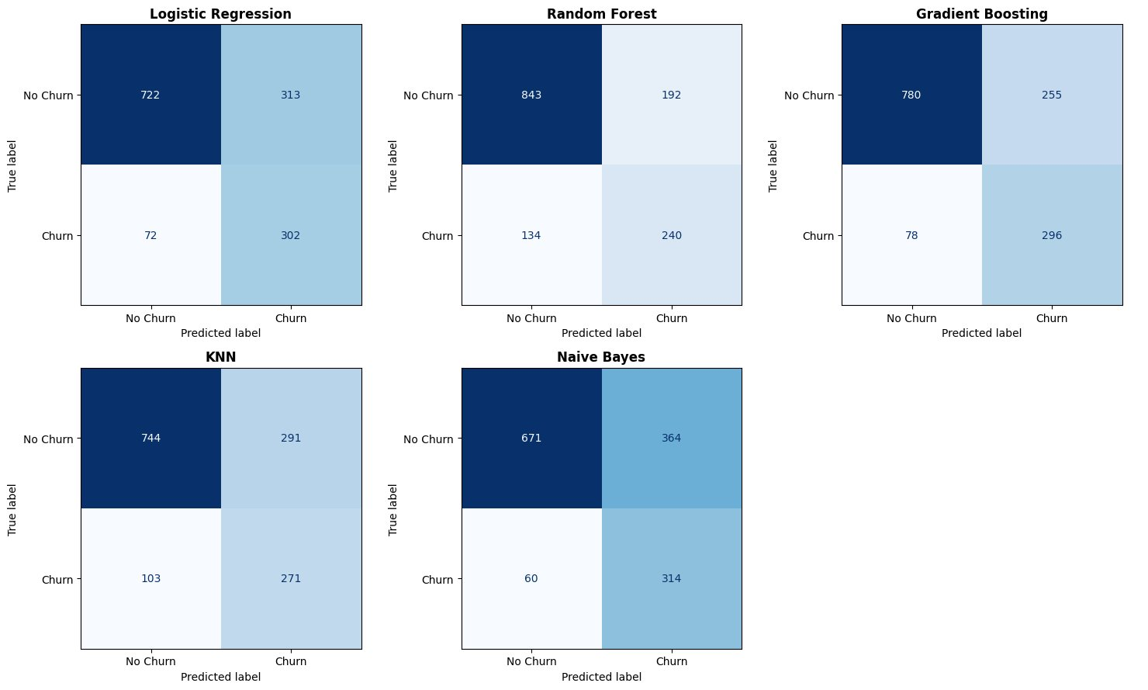
Milestone 3 — Confusion Matrices (All Models)

